Slide 1

PROJECT A
BLOCKCHAIN-BASED SECURE AND TRANSPARENT VOTING SYSTEM FOR CORPORATIONS
MICHAEL ORINA
SCII/00825/2019
14TH APRIL, 2023

Slide 2
INTRODUCTION
How is the process of voting for Shareholders?
What problems arise with traditional voting Systems?
How do you solve the problem where shareholders cannot attend AGM?
What does Blockchain-Based Secure and Transparent Voting System Solve?

Slide 3
BACKGROUND STUDY
Voting is an essential process in corporations, and the method used for voting can vary depending on different factors.
How did we reach here?
Traditional Voting methods.
Improvement by introducing voting by proxy.
Pre- corona voting methods.
Post-Corona voting methods
The future of cooperate voting.

Slide 4
PROBLEM STATEMENT
"Evaluating the effectiveness of blockchain-based voting systems in enhancing shareholder participation and reducing voting fraud in corporate elections."
The research involves a comparative study of traditional voting systems and blockchain-based voting systems, examining factors such as voter turnout, the accuracy of vote counting, and the level of transparency and security in the voting process
The findings of this research could inform the decision-making of corporations considering the implementation of blockchain-based voting systems

Slide 5
OBJECTIVES
Main Objective:
The system aims to improve the integrity and efficiency of corporate voting processes and
promote trust and accountability among shareholders.
Specific Objectives:
1. To develop a web-based blockchain application where stakeholders can log
in and vote for their respective publicly listed companies.
2. To compare the blockchain-based voting system's performance and efficiency with the traditional system in terms of various factors such as security, transparency, time, cost, accuracy, and voter satisfaction.
3. To implement a personal access token that enables the identification of the voting shareholders.
4. To develop a real-time vote counting and display system using smart contracts.
5. To design and develop a system where shareholders can view their voting history and print the results.

Slide 6
SCOPE
Issuing shareholders digital tokens that represent ownership in the company.
Creating a secure online portal to notify shareholders once a vote is called for
Creating a blockchain platform to record votes cast in a tamper-proof manner
Automating vote counting process through smart contract technology
Displaying results of the vote in real-time
Provide a secure way of auditing the results of the vote
Include a way shareholders can view voting history and print results

Slide 7
JUSTIFICATION
1. Improved Corporate Governance by increasing transparency, accountability, and integrity of the decision-making process.
2. Enhanced Security by providing stronger security features compared to traditional voting systems.
3. Improved Efficiency by reducing the time and cost associated with traditional voting systems.
4. Alignment with Technology Trends. Blockchain technology is gaining adoption in various industries as a standard for secure and transparent data management.
5. Improved Stakeholder Satisfaction.

Slide 8
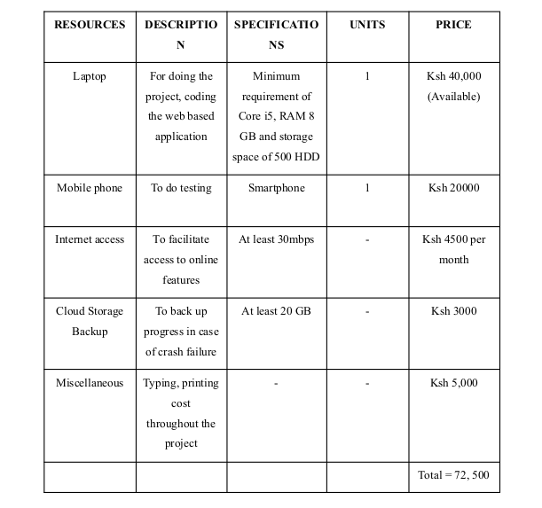
COST/REQUIREMENTS

Slide 9
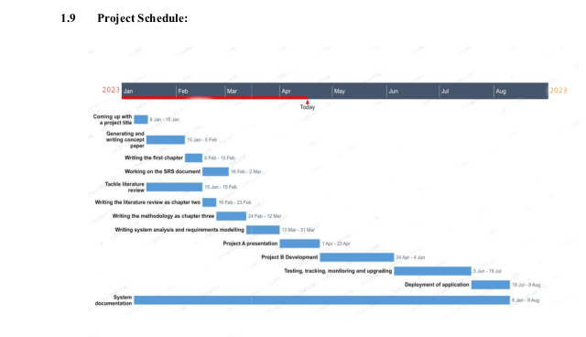
PROJECT SCHEDULE

Slide 10
LITERATURE REVIEW
USSD CODE VOTING
What is USSD Code Voting?
USSD voting is a type of mobile voting system that allows shareholders to cast their votes on resolutions or proposals using their mobile phones via a USSD code. In Kenya, the USSD code for voting is *483*code#, where "code" represents a unique voting code provided by the company.
What are the Pros?
What are the Cons?

Slide 11
LITERATURE REVIEW cont.
C & G GROUP
Who are C & R Group?
C & R Group is a Kenyan firm, founded in 2010, that specializes in providing end-to-end solutions for the efficient management of AGMs for companies listed on the NSE. The firm offers a comprehensive range of services that aid in the voting process during AGMs
What are their Pros?
What are their Cons?

Slide 12
LITERATURE REVIEW cont.
COMPUTER SHARE VIRTUAL MEETING SERVICES
Who are CSVMS?
Computershare Limited is an Australian stock transfer company, founded in 1978, that provides corporate trust, stock transfer, investor services for shareholders and employee share plan services in many countries. It has found its way to Kenya through ABSA Group Limited
What are their Pros?
What are their Cons?

Slide 13
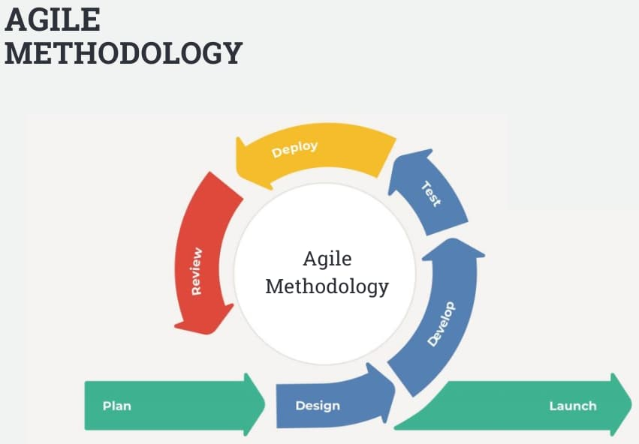
METHODOLOGY/DEVELOPMENT TOOLS

Slide 14
SYSTEM ANALYSIS AND REQUIREMENTS MODELING
DATA COLLECTION METHODS
Questionnaires
Interviews
Observation
Literature Review

Slide 15
SYSTEM ANALYSIS AND REQUIREMENTS MODELING cont.’
RESOURCES REQUIRED
Laptop - Used as the working platform for this project
Processor speed – Intel (R) Core i5 ,2.60GHz
Memory requirements – Minimum of 4 GB RAM.
Hard disk capacity – Minimum of 500 GB.
VSCodium Metamask ParrotOS
ReactJs Remix IDE
NodeJs Github

Slide 16
REFERENCES
Absa_Group_Limited https://en.wikipedia.org/wiki/Absa_Group_Limited
Blockchain Technology Market Worth $1,431.54 Billion By 2030 report by Grand View Research, Inc.
https://www.grandviewresearch.com/press-release/global-blockchain-technology-market
Candrgroup https://digital.candrgroup.co.ke/
Computershare https://en.wikipedia.org/wiki/Computershare
“Cryptocurrency Market By Offering, Process, Type, and End User: Global Opportunity Analysis and Industry Forecast, 2021–2030” by Allied Market Research https://www.grandviewresearch.com/industry-analysis/blockchain-technology-market
Electoral system https://en.wikipedia.org/wiki/Electoral_system
Listed Companies https://www.nse.co.ke/listed-companies/
The Broadridge Next-Gen Technology Adoption Survey Financial services leaders are taking steps to gain a clear advantage.
https://www.broadridge.com/_assets/pdf/broadridge-next-gen-technology-adoption-survey.pdf
The_Future_of_Electronic_Voting_System_Using_Blockchain/links/5fc63c74299bf1a422c804ce
/The-Future-of-Electronic-Voting-System-Using-Blockchain.pdf
https://www.researchgate.net/profile/Mstarifa-Khatun/publication/339292454_https://papers.ssrn.com/sol3/papers.cfm?abstract_id=2977522
What-is-agile-methodology https://ded9.com/what-is-agile-methodology/

